Slide 1

Countering Race Attacks for Zero-Confirmation Transactions in the Bitcoin Network
Chris Baumler

Slide 2
Introduction
Bitcoin is a distributed payment system that uses a proof-of-work (PoW) system to verify transactions.
The Bitcoin PoW is designed to verify transactions with an average time of 10 minutes.
Some applications cannot wait this long and are vulnerable to double spending.

Slide 3
The Bitcoin Network
Consists of peers that send transactions
Miners perform a proof of work to add blocks to the blockchain
Branches can form in the blockchain if multiple blocks are submitted at the same time
Longest branch wins
Altering a transaction already in the blockchain requires significant resources

Slide 4
Types of Double Spending Attacks
Race Attack
Finney Attack
Vector76 Attack
Brute Force Attack
51% Attack

Slide 5
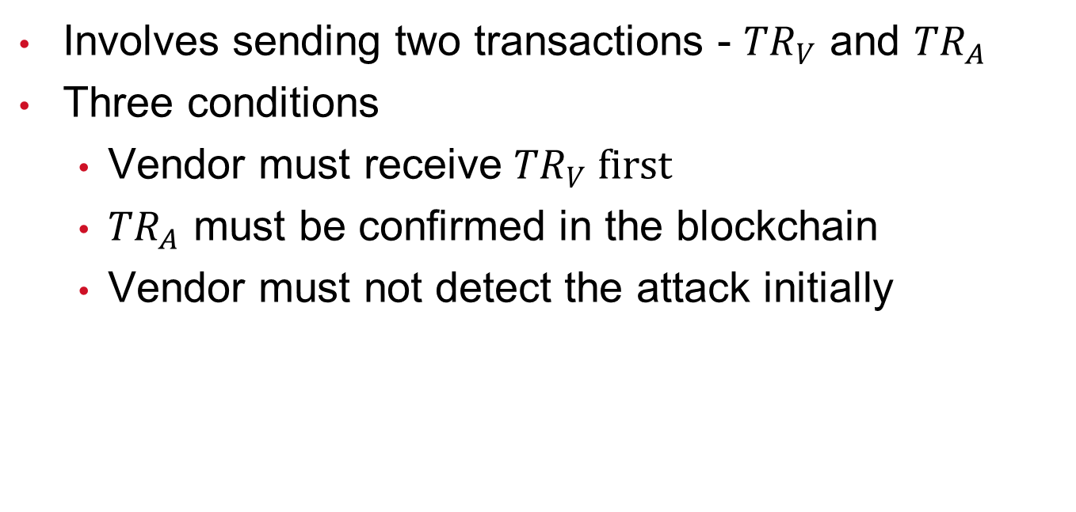
Performing a Successful Race Attack
Involves sending two transactions - ${TR}_{V}$ and ${TR}_{A}$
Three conditions
Vendor must receive ${TR}_{V} first$
${TR}_{A}$ must be confirmed in the blockchain
Vendor must not detect the attack initially

Slide 6
Overview of Proposed Solutions
Listening Period
Observers
Forwarding Double Spend Attempts
Verifiable Code Execution

Slide 7
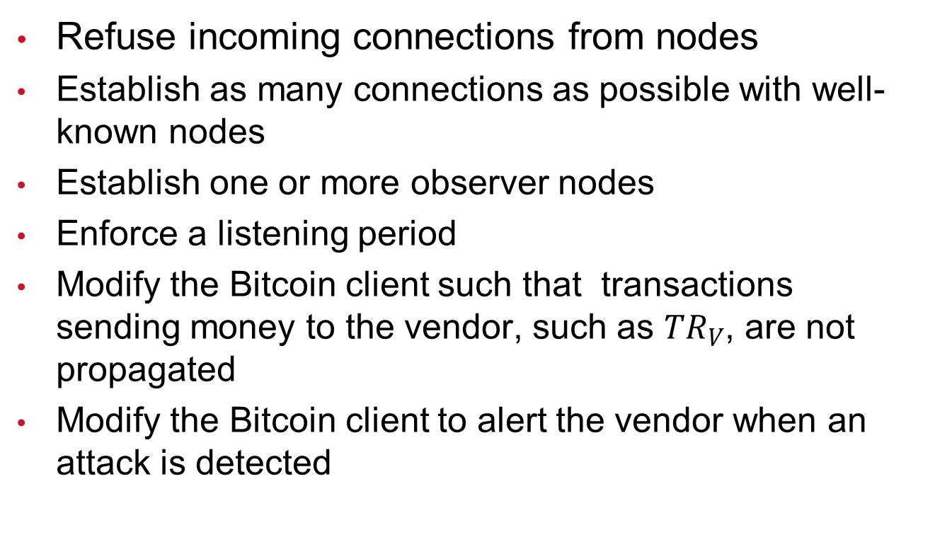
A Hybrid Approach
Refuse incoming connections from nodes
Establish as many connections as possible with well-known nodes
Establish one or more observer nodes
Enforce a listening period
Modify the Bitcoin client such that transactions sending money to the vendor, such as ${TR}_{V}$, are not propagated
Modify the Bitcoin client to alert the vendor when an attack is detected

Slide 8
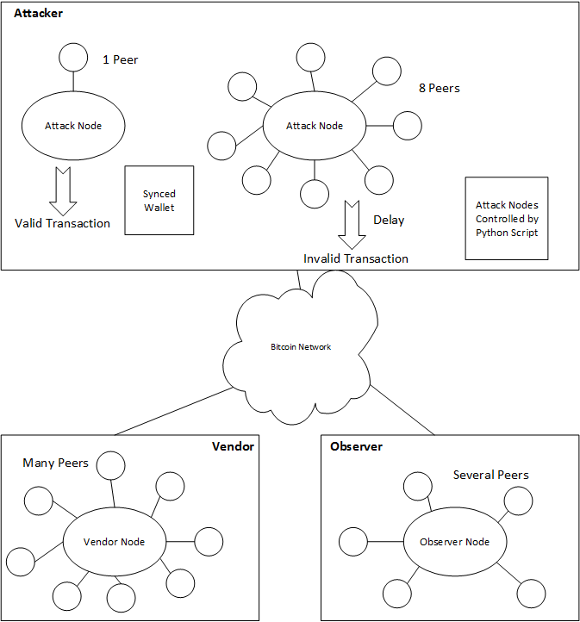
Testing the Hybrid Approach

Slide 9
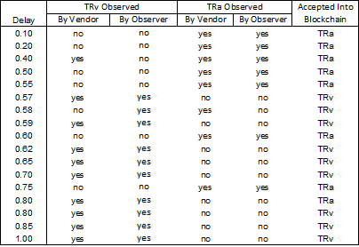
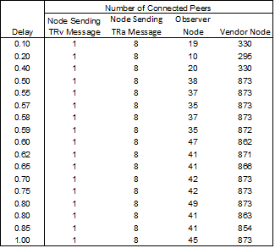
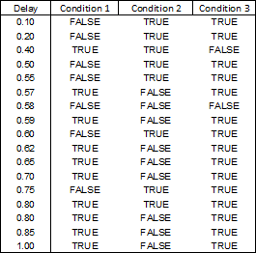
Evaluating the Hybrid Approach

Slide 10
Conclusion
Discussed details of Bitcoin network
Examined double spending attacks
Looked at proposed solutions
Evaluated a new hybrid solution

